Slide 1
Employee Data Analysis using Excel
STUDENT NAME:PRIYANGA.V
REGISTER NO:122204026
DEPARTMENT:B.COM CORPORATE SECRETARYSHIP
COLLEGE: SHRI KRISHNASWAMY COLLEGE FOR WOMEN

Slide 2
PROJECT TITLE
Employee Gender Analysis using Excel

Slide 3


AGENDA
Problem Statement
Project Overview
End Users
Our Solution and Proposition
Dataset Description
Modelling Approach
Results and Discussion
Conclusion
3/21/2024 Annual Review

Slide 4

PROBLEM STATEMENT As an HR analyst, you have been tasked with conducting a comprehensive gender analysis of the organization’s workforce. The goal is to understand the current gender distribution, identify potential gender disparities, and inform diversity and inclusion initiatives. Objectives: 1. Calculate the overall gender ratio of the organization. 2. Analyze the gender distribution across different departments, job titles, and locations. 3. Identify underrepresented gender groups in various areas of the organization. 4. Visualize the findings using charts and graphs to facilitate easy understanding and decision-making.

Slide 5

PROJECT OVERVIEW Objective:To conduct a comprehensive analysis of the organization’s workforce to understand the current gender distribution, identify potential gender disparities, and inform diversity and inclusion initiatives. Scope: - Analyze employee data across various dimensions (department, job title, location) - Calculate gender ratios and percentages Deliverables: 1. Comprehensive report summarizing the analysis 2. Excel worksheets with pivot tables, charts, and graphs Timeline: - Data collection and preparation: 2 days - Analysis and visualization days
.

Slide 6

WHO ARE THE END USERS? 1. HR Leadership: To inform strategic decisions on diversity, equity, and inclusion initiatives. 2. Diversity and Inclusion Team: To develop targeted programs and interventions addressing gender disparities. 3. Department Heads: To understand gender distribution within their teams and identify areas for improvement. 4. Employee Resource Groups (ERGs): To support gender-specific initiatives and advocate for change. 5. Senior Management: To provide insights for decision-making on talent development, succession planning, and organizational culture.

Slide 7
OUR SOLUTION AND ITS VALUE PROPOSITION 1. Enhance Diversity and Inclusion: Identify and address gender disparities, fostering a more inclusive workplace culture. 2. Improve Talent Management: Develop targeted initiatives to attract, retain, and promote top talent from underrepresented gender groups. 3. Boost Employee Engagement: Create a more equitable work environment, leading to increased employee satisfaction and productivity. 4. Support Business Objectives: Drive business success by leveraging diverse perspectives, improving decision-making, and enhancing reputation. 5. Meet Regulatory Requirements: Ensure compliance with equal employment opportunity laws and regulations.

Slide 8
Dataset Description 1. *Employee ID*: Unique identifier for each employee 2. *Gender*: Employee’s self-identified gender (Male, Female, Non-binary, Prefer not to disclose) 3. *Department*: Employee’s department or team 4. *Job Title*: Employee’s job title or position 5. *Location*: Employee’s work location (city, state, country) 6. *Job Level*: Employee’s job level or grade 7. *Hire Date*: Employee’s hire date 8. *Tenure*: Employee’s tenure with the organization (in years) 9. *Full-time/Part-time*: Employee’s work status (Full-time, Part-time) 10. *Manager ID*: Employee’s manager or supervisor

Slide 9

THE "WOW" IN OUR SOLUTION W - Wide-ranging Insights: Our solution provides a comprehensive analysis of gender distribution across various dimensions, including department, job title, location, and job level. O - Objective Recommendations: We offer data-driven, actionable recommendations to address gender disparities, ensuring objective decision-making. W - Workplace Transformation: Our solution empowers organizations to create a more inclusive workplace culture, driving business success and employee satisfaction.
3/21/2024 Annual Review
9

Slide 10
MODELLING
1. Descriptive Analytics: - Gender distribution across departments, job titles, locations, and job levels - Identification of underrepresented gender groups 2. Inferential Analytics: - Statistical analysis to identify significant differences in gender representation - Hypothesis testing to determine if differences are due to chance or underlying factors 3. Predictive Analytics: - Modeling to forecast future gender distribution based on trends and patterns - Identification of potential barriers to gender parity 4. Prescriptive Analytics: - Development of targeted initiatives to address gender disparities - Recommendations for diversity and inclusion strategies
10

Slide 11
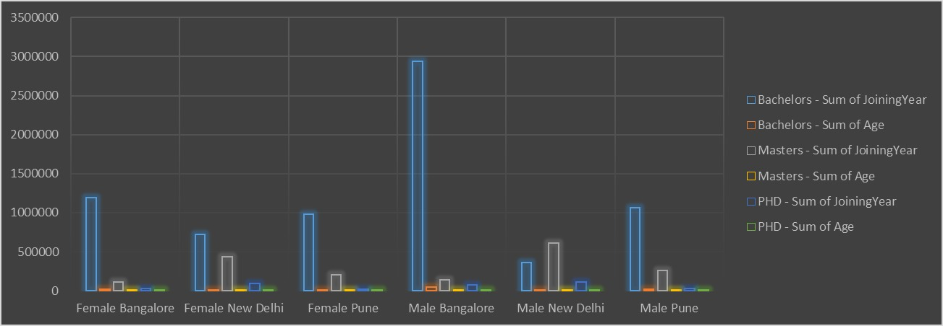
RESULTS
11

Slide 12
Conclusion The Employee Gender Analysis has provided valuable insights into the current state of gender diversity within the organization. The findings highlight areas of strength and weakness, identifying opportunities to improve gender representation and address disparities.

